Slide 1



KONGU ENGINEERING COLLEGE
PERUNDURAI ERODE-638060
DEPARTMENT OF ARTIFICIAL INTELLIGENCE AND DATA SCIENCE
ENDOCORE WORKSTATION: MULTIMODEL AGENTIC FRAMEWORK FOR INTELLIGENT WORKSPACE MONITORING USING ACTIVITY TRACKING
Team Members: Tawfeeq B (23ADR172)
Subiksha M (23ADR163)
Pugazhvendhan A (23ADR135)
Team Mentor : Ms.M.Harini, AP/AI

Slide 2

Sustainable Development Goal ( SDG)
Sustainable Development Goal: SDG 9 – Industry, Innovation and Infrastructure
Contribution of the project:
Promotes AI-driven software development.
Enhances productivity through autonomous AI agents.
Encourages innovation using Agentic AI and LLMs.
Supports intelligent digital infrastructure for collaborative work.
Improves software engineering efficiency with real-time monitoring and AI assistance.
Outcome:
Faster software development
Improved team collaboration Increased innovation
Smarter and more sustainable digital workplaces
"Our project supports SDG 9 by leveraging Agentic AI and Large Language Models to build an innovative, intelligent, and efficient software development environment."

Slide 3
SYSTEM STUDY – PROBLEM STATEMENT
EXISTING PROBLEMS:
No intelligent monitoring of developer progress
Team members work in isolation
Difficult to identify blocked developers
Lack of personalized AI assistance
High cognitive workload
Delayed project completion
EXISTING SYSTEM:
Traditional project monitoring tools include:
Jira
Trello
GitHub Projects
VS Code Extensions

Slide 4
PROJECT GOAL
Project Goal: To develop an AI-powered multi-agent workspace monitoring system that intelligently observes developers' activities, identifies productivity bottlenecks, and provides autonomous assistance using Large Language Models (LLMs).
Objectives:
Monitor developer activities in real time
Detect when developers are stuck
Provide AI-generated suggestions
Improve collaboration among team members
Reduce cognitive overload

Slide 5
PROPOSED SYSTEM
PROPOSED IDEA:
A Multi-Agent AI Workspace consisting of intelligent software agents.
Agents:
Observation Agent:
Monitors coding activity
Tracks compile errors
Detects idle time
Records Git activities
Scrum Coordination Agent
Uses Gemini LLM
Identifies blocked developers
Suggests teammates with similar solutions
Generates coding recommendations
Wellness Agent
Monitors work duration
Detects cognitive overload
Suggests short breaks

Slide 6
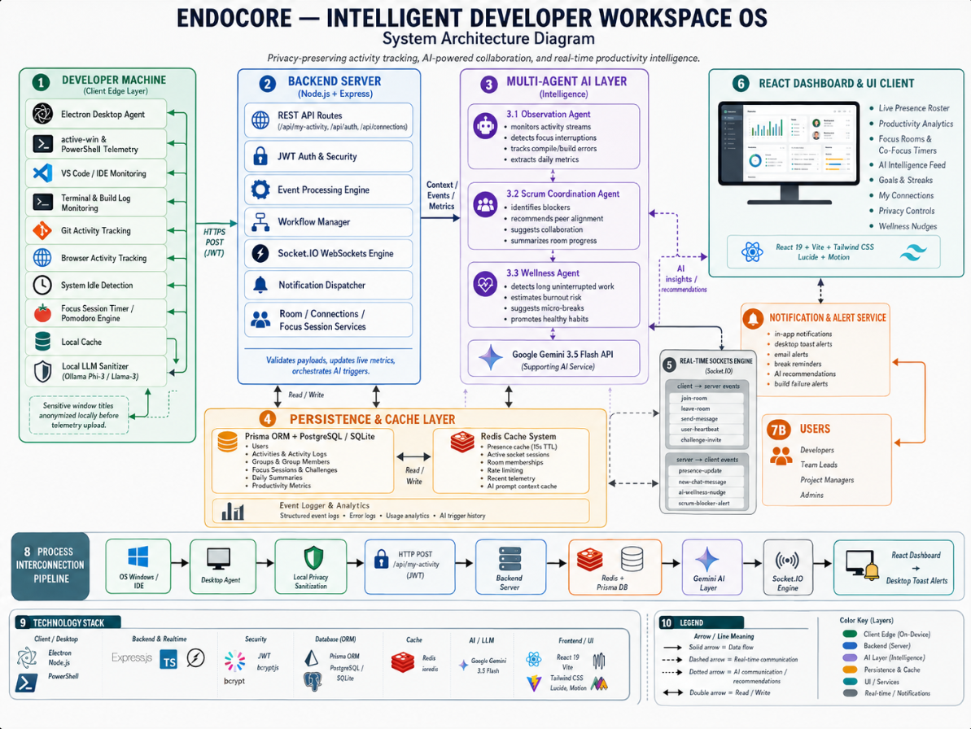

Slide 7
PROPOSED FEATURES:
✔ Real-time developer monitoring
✔ AI-powered assistance
✔ Multi-agent collaboration
✔ Automatic issue detection
✔ Smart developer matching
✔ Productivity analytics
✔ Wellness recommendations
✔ Live dashboard

Slide 8
Algorithms & Technologies
Agentic AI
Autonomous decision-making agents
Large Language Model
Gemini 3.5 Flash API
Event-Driven Architecture
Socket.IO
Context Analysis
Developer activity analysis
Pattern Recognition
Repeated build failures
Recommendation Engine
Suggests solutions using LLM

Slide 9
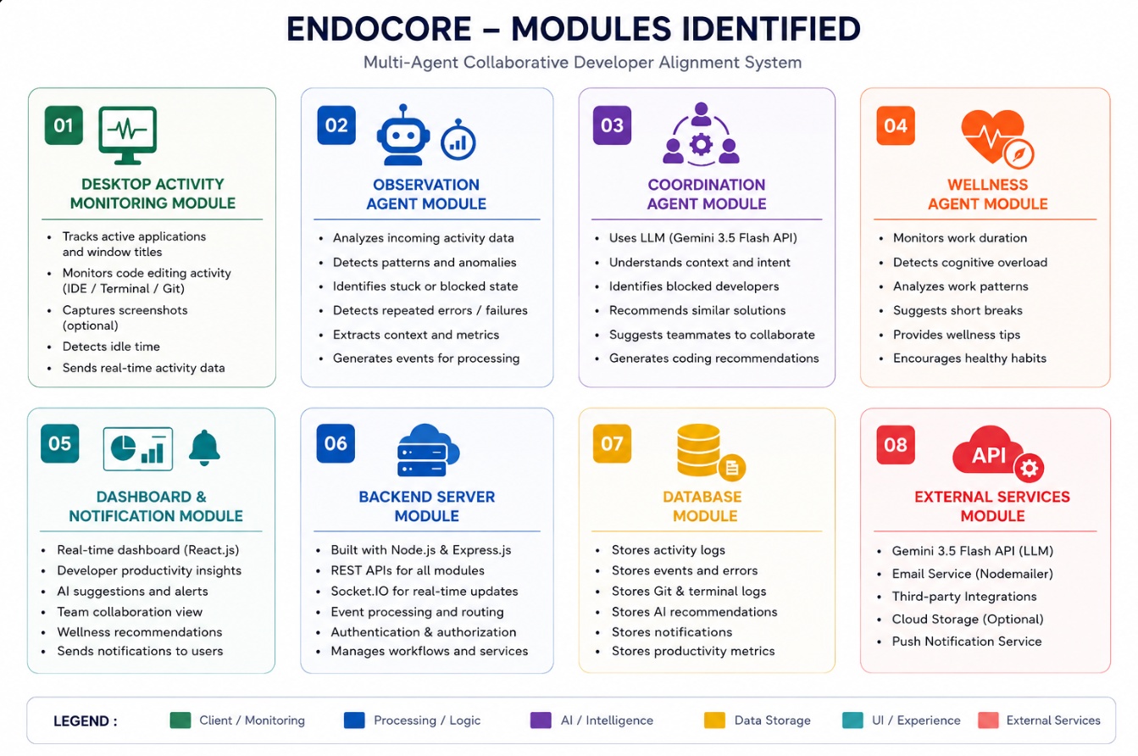

Slide 10
TECHNOLOGY STACK
COMPONENT | TECHNOLOGIES
FRONTEND | REACT.JS
BACKEND | EXPRESS.JS
DESKTOP | ELECTRON.JS
AI MODEL | GEMINI 3.5 FLASH
DATABASE | SQLite
COMMUNNICATION | SOCKET.IO
VERSION CONTROL | GIT
LANGUAGE | JAVASCRIPT

Slide 11
FUTURE ENHANCEMENTS:
Voice-based AI assistant
Multi-LLM support
Mobile application
Predictive sprint planning
Object detection integration
Cloud deployment
Team performance forecasting

Slide 12
REFERENCES:
Attal, F., et al. (2015). Physical Human Activity Recognition Using Wearable Sensors. Sensors, 15, 31314–31338.
Elangovan, R., Perumal, T., & Padmavathi, S. (2021). Human Activity Recognition With Smartphone and Wearable Sensors Using Deep Learning Techniques: A Review. IEEE Sensors Journal.
Li, L., et al. (2020). A Review of Applications in Federated Learning. Computers & Industrial Engineering, 149, 106854.
Trotta, A., et al. (2024). Edge Human Activity Recognition Using Federated Learning on Constrained Devices. Pervasive and Mobile Computing, 104, 101972.
Kabir, M. R., Borshon, R. H., & Khan, R. (2025). Federated Learning for Human Activity Recognition: Balancing Privacy, Efficiency, and Accuracy Through Innovative Aggregation Techniques. Array, 27, 100462.

Slide 13
Thank You !!

